Slide 1
Alternate method of multipliers(ADMM)
By Sivamaran.M.A.C

Slide 2
What is ADMM
Alternating direction method of multipliers (ADMM), a simple but powerful algorithm that is well suited to distributed convex optimization
closely related to many other algorithms, such as dual decomposition, the method of multipliers, Douglas-Rachford splitting, Spingarn's method of partial inverses, Dykstra's alternating projections, proximal methods, and others

Slide 3
Advantages
Good convergence properties for approximate solutions due to lagrangian multiplier
Uses decomposability like dual ascend algorithms

Slide 4
Practicalities and tricks
ADMM obtains a relatively accurate solution in a handful of iterations, but requires many, many iterations for a highly accurate solution
Choice of ρ can greatly influence practical convergence of ADMM
ρ too large → not enough emphasis on minimizing f1 + f2
ρ too small → not enough emphasis on feasibility
Like deriving duals, getting a problem into ADMM form often requires a bit of trickery (and different forms can lead to different algorithms)

Slide 5
Forms:
Basis pursuit
LASSO
LAD
Huber loss
Linear Programming
Quadratic Programming

Slide 6
Lasso(Least Absolute shrinkage and Selection Operator):
It is an l₁ regularized linear regression that involves solving given condition,
Can be used to solve sparse systems

Slide 9
MATLAB code:

Slide 11
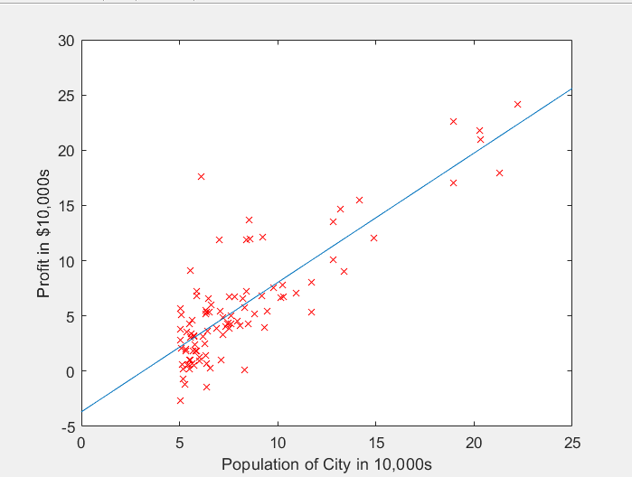
Linear regression through ADMM solver for LASSO:

Slide 12
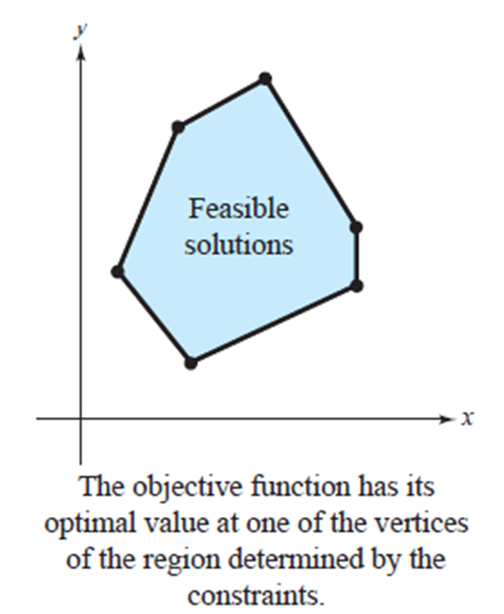
Linear programming
Linear programming, mathematical modeling technique in which a linear function is maximized or minimized when subjected to various constraints.
A two-dimensional linear programming problem consists of a linear objective function and a system of linear inequalities called constraints.
The objective function gives the quantity that is to be maximized (or minimized), and the constraints determine the set of feasible solutions.

Slide 13
Optimal Solution of a Linear Programming Problem
If a linear programming problem has a solution, it must occur at a vertex of the set of feasible solutions.
If the problem has more than one solution, then at least one of them must occur at a vertex of the set of feasible solutions. In either case, the value of the objective function is unique.

Slide 17
MATLAB code:

Slide 18
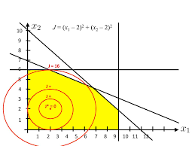
Quadratic programming
process of solving a special type of mathematical optimization problem—specifically, a (linearly constrained) quadratic optimization problem

Slide 20
MATLAB code:

Slide 21

Basis pursuit
equality-constrained l₁ minimization problem
It is applied in modern statistical signal processing
$$\begin{matrix}General form: \\ minimize {||x||}_{1} \\ subject to Ax = b\end{matrix}$$

Slide 22
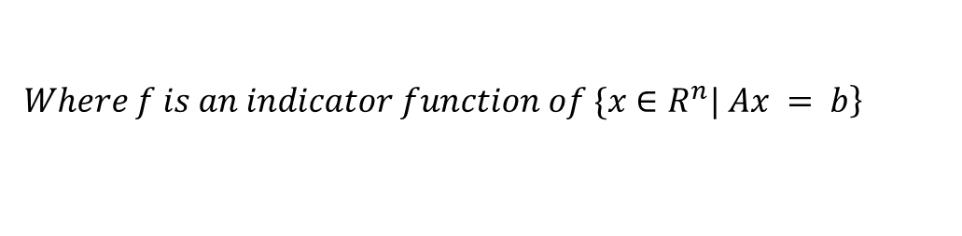
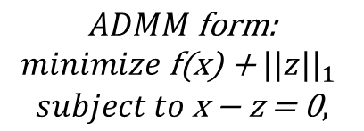
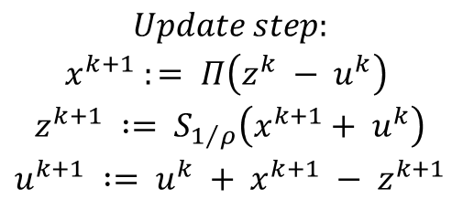
$$\begin{matrix}ADMM \text{form}\text{:} \\ minimize \text{f}\text{(}\text{x}\text{) + }{||z||}_{1} \\ subject to \text{x}\text{ − }\text{z}\text{ = 0},\end{matrix}$$
$$\left.Where f is an indicator function of \{x∈R^{n}| Ax = b\right\}$$
$$\begin{matrix}Update step: \\ x^{k+1 }:= Π\left(z^{k} − u^{k}\right) \\ z^{k+1} := S_{1/ρ}\left(x^{k+1}+ u^{k}\right) \\ u^{k+1} := u^{k} + x^{k+1} − z^{k+1}\end{matrix}$$

Slide 23
MATLAB code:

Slide 25
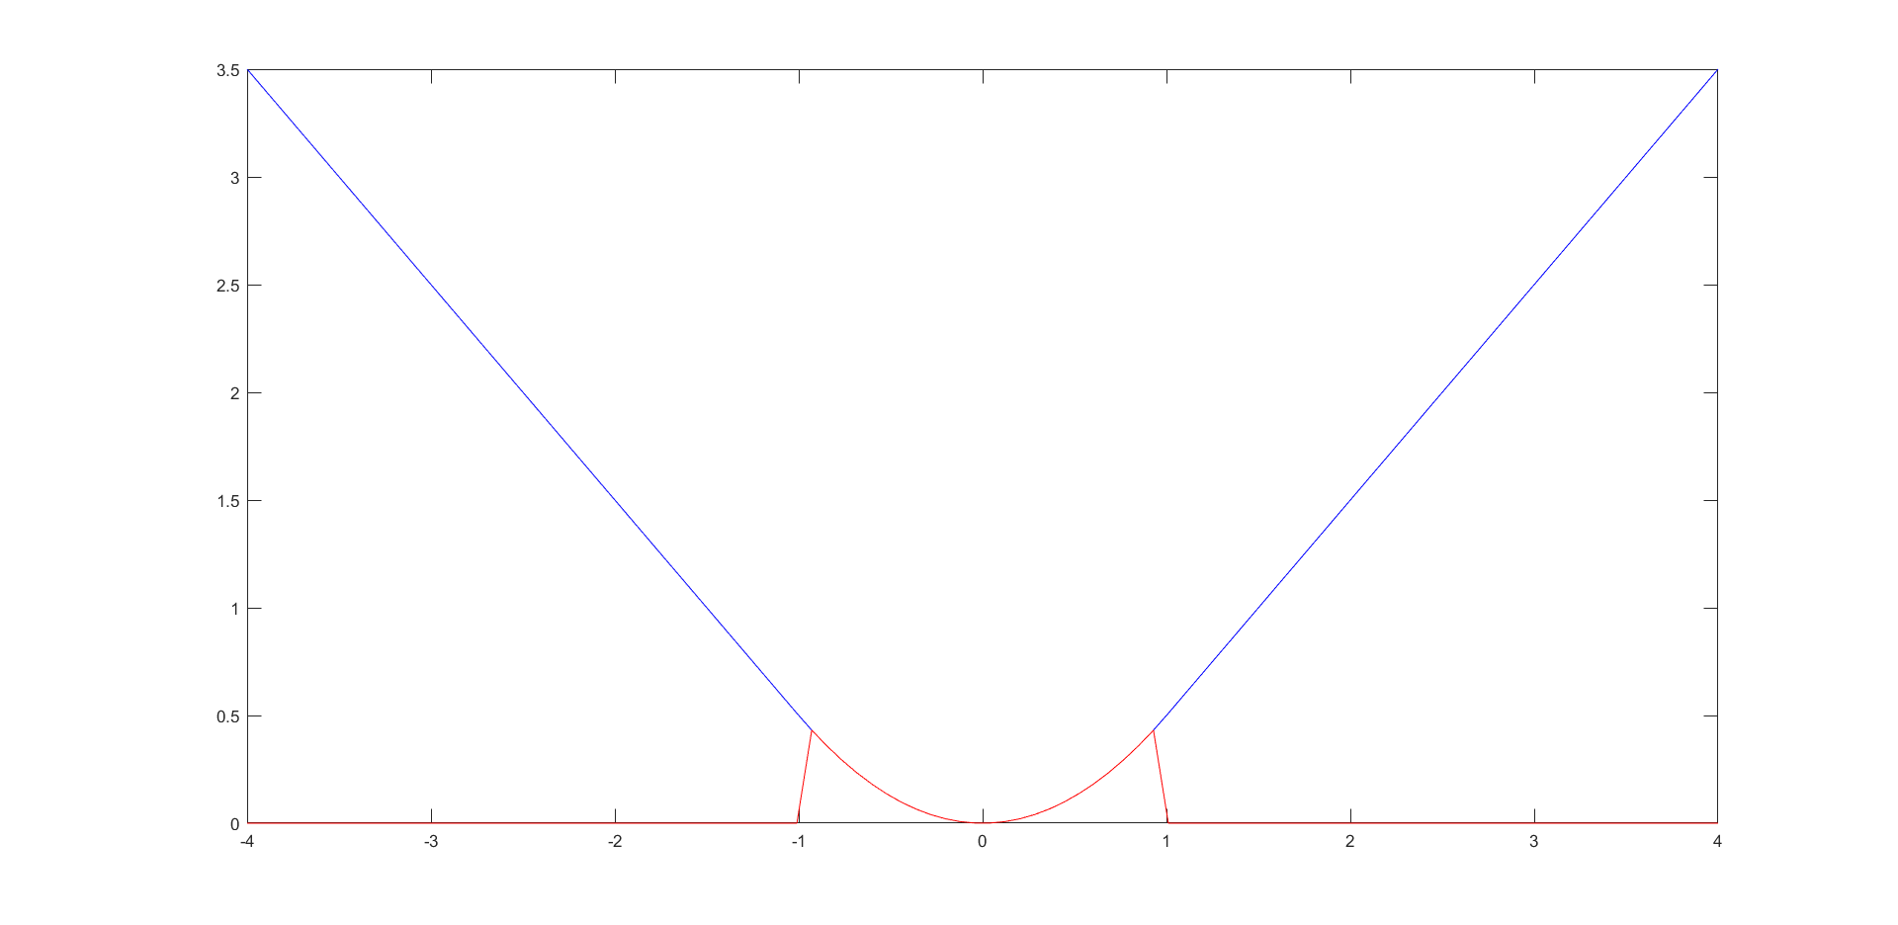
Huber Loss
From range -1 to 1 it is least score loss, beyond that ,loss increases linearly with deviation
Huber loss is a loss function used in robust regression,

Slide 28
MATLAB code:

Slide 31
Least absolute deviations (LAD)
Also known as L1 method
Instead of minimizing the sum of squared errors for statistical analysis of regression, it minimizes the sum of absolute values of errors.

Slide 32
MATLAB code:

Slide 35
Thank you!!

